Slide 1

Using Graph Neural Networks to Solve Scheduling Problems
Student: Hazar Çakır
Supervisor: Prof. Dr. Martin Grunow
Advisor: M.Sc. Jan-Niklas Dörr
Technische Universität München
Chair of Production and Supply Chain Management
TUM School of Management
Munich, 16 July 2024

Slide 2
Introduction
What I am going to talk about today:
Summary of the Project
Problem Definition and Motivation
Algorithm and Implementation details:
Results and Analysis
Discussions and Q/A

Slide 3
Project Summary
Main goal:
Development of Deep Reinforcement Learning models to optimize job scheduling on a production line with the help of Graph Neural Networks
Development of Environment Model and Heuristic and PPO Agents
To represent the problem, we first designed and implemented an environment model incorporating all relevant problem properties. Next, we implemented a heuristic model and a standard PPO model as the foundation.
Implementing the Graph Neural Network approach
As a unique contribution to the project, we implemented and tested a novel approach using graph neural networks for flexible state representation. This new method was then compared with previous models.

Slide 4
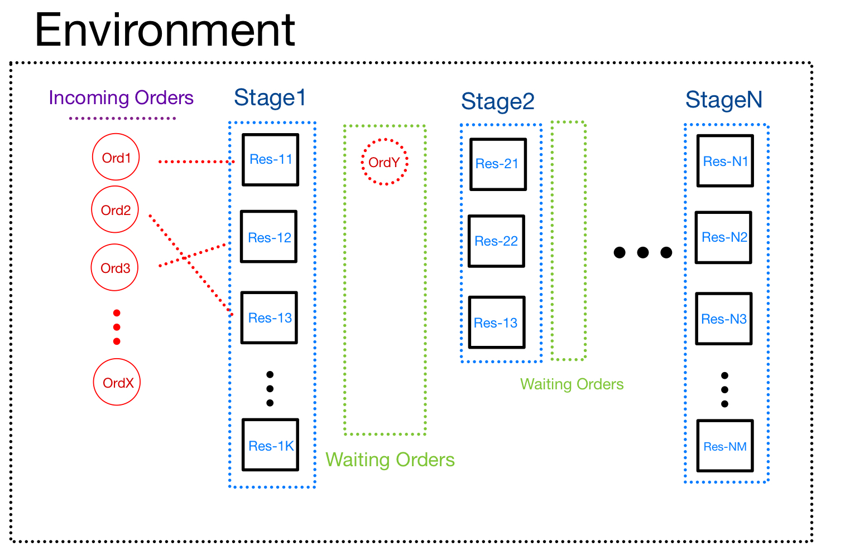
Problem Definition - Environment
Job Shop Scheduling Problems (JSSP) involve the assignment and sequencing of jobs to machines. Each job in JSSP comprises a series of tasks that need to be completed in a specific order.

Slide 5
Products:
Product_1
Product_2
Product_3
Notes:
The scheduling problem is represented using a production line, which includes multiple machines referred to as "Resources". These resources are systematically organized into stages, with each resource assigned to a specific stage and stages sequentially numbered.
In our model, the items produced on the production line are referred to as "Orders". Each order is associated with a specific "Product" type and has a due date by which it should be completed.
The system defines various product types, each with distinct characteristics, composed of sequential "Operations". Each operation occurs at a designated stage within the production line.

Slide 6
Problem Definition - Environment
Operation and Resource Compatibility
The compatibility between operations and resources varies depending on the product type. For example, "Operation 1" at stage 1 may have different compatible resources for "Product 1" compared to "Product 2", even within the same stage.
Set-up and Processing Times
Each product type has associated "Set-up Times" and "Processing Times" when processed on a resource. The processing time refers to the duration required to manufacture a given product type on that resource.
Set-up time is the period needed to prepare the resource for processing a different type of product. If successive products processed on a resource are of the same type, the set-up time is effectively zero. However, switching between different product types incurs a specific set-up time.

Slide 7
Problem Definition - Environment
Flexibility in Resource Selection
A unique aspect of our scheduling problem is the flexibility in selecting resources within a stage for each order. Each operation in an order offers the possibility of choosing from among compatible resources in a stage. This choice represents a critical juncture in the decision-making process.
Waiting Periods and Resource Management
Orders may experience waiting periods between stages after being processed by a resource, although they release the resource immediately following the processing time. This aspect is crucial for managing resource allocation and ensuring efficient flow through the production line.

Slide 8
Implementation - Models
Our model comprises two key sub-models. The first is the GNN-State model, responsible for learning and representing the state of the environment. The second is the Actor-Critic model, which processes this state information to determine the appropriate actions. Both models are trained simultaneously, with the output from the GNN-State model serving as input for the Actor-Critic model.
GNN-State Model
Learns and represents the state of the environment.
Actor-Critic Model
Processes the state to determine the appropriate actions.
Trained simultaneously with the GNN-State model, using its output as input.

Slide 9
Implementation - Models
Deep Reinforcement Learning Approach
Within deep reinforcement learning, we selected the Proximal Policy Optimization (PPO) model due to its effectiveness in managing complex, dynamic, and uncertain environments. PPO is known for its robustness and stability in training, which is essential for the unpredictable nature of job shop scheduling problems.
Rather than utilizing a pre-existing model from a library, we opted to implement the model ourselves. This approach allowed us to seamlessly integrate Graph Neural Network (GNN) layers, enhancing the model's adaptability to our specific requirements.
Notes:
The training of the Actor-Critic model follows the standard principles of Proximal Policy Optimization (PPO). This involves using a policy gradient method for optimization, where clipped probability ratios ensure that updates do not deviate excessively from the current policy. This approach promotes stable and consistent learning. Additionally, PPO alternates between sampling data through interaction with the environment and optimizing a "surrogate" objective function, thereby maximizing efficiency by reusing data across multiple epochs of stochastic gradient ascent.

Slide 10
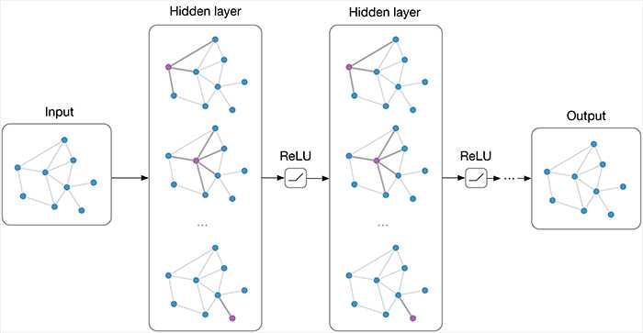
Implementation - Models
Graph Neural Networks
GNNs are a class of deep learning models designed to
capture the dependence of graphs via message passing
between the nodes of graphs.
Unlike traditional neural networks, which assume that
inputs are independent of each other, GNNs maintain the
relational information inherent in the data.
Notes:
GNNs operate on the principle of message passing, where nodes aggregate information from their neighbors through successive layers.
This process is divided into two steps: aggregation and update.
Aggregation: Each node collects and combines messages from its neighbors, using functions such as sum, mean, or max.
Update: Nodes then update their own state by applying a transformation, usually via a neural network, to the aggregated information.
GNNs typically include several layers of message passing steps to enable deep learning on graphs.Each layer outputs a new set of node features, encapsulating node properties and the topological structure of the graph.

Slide 11
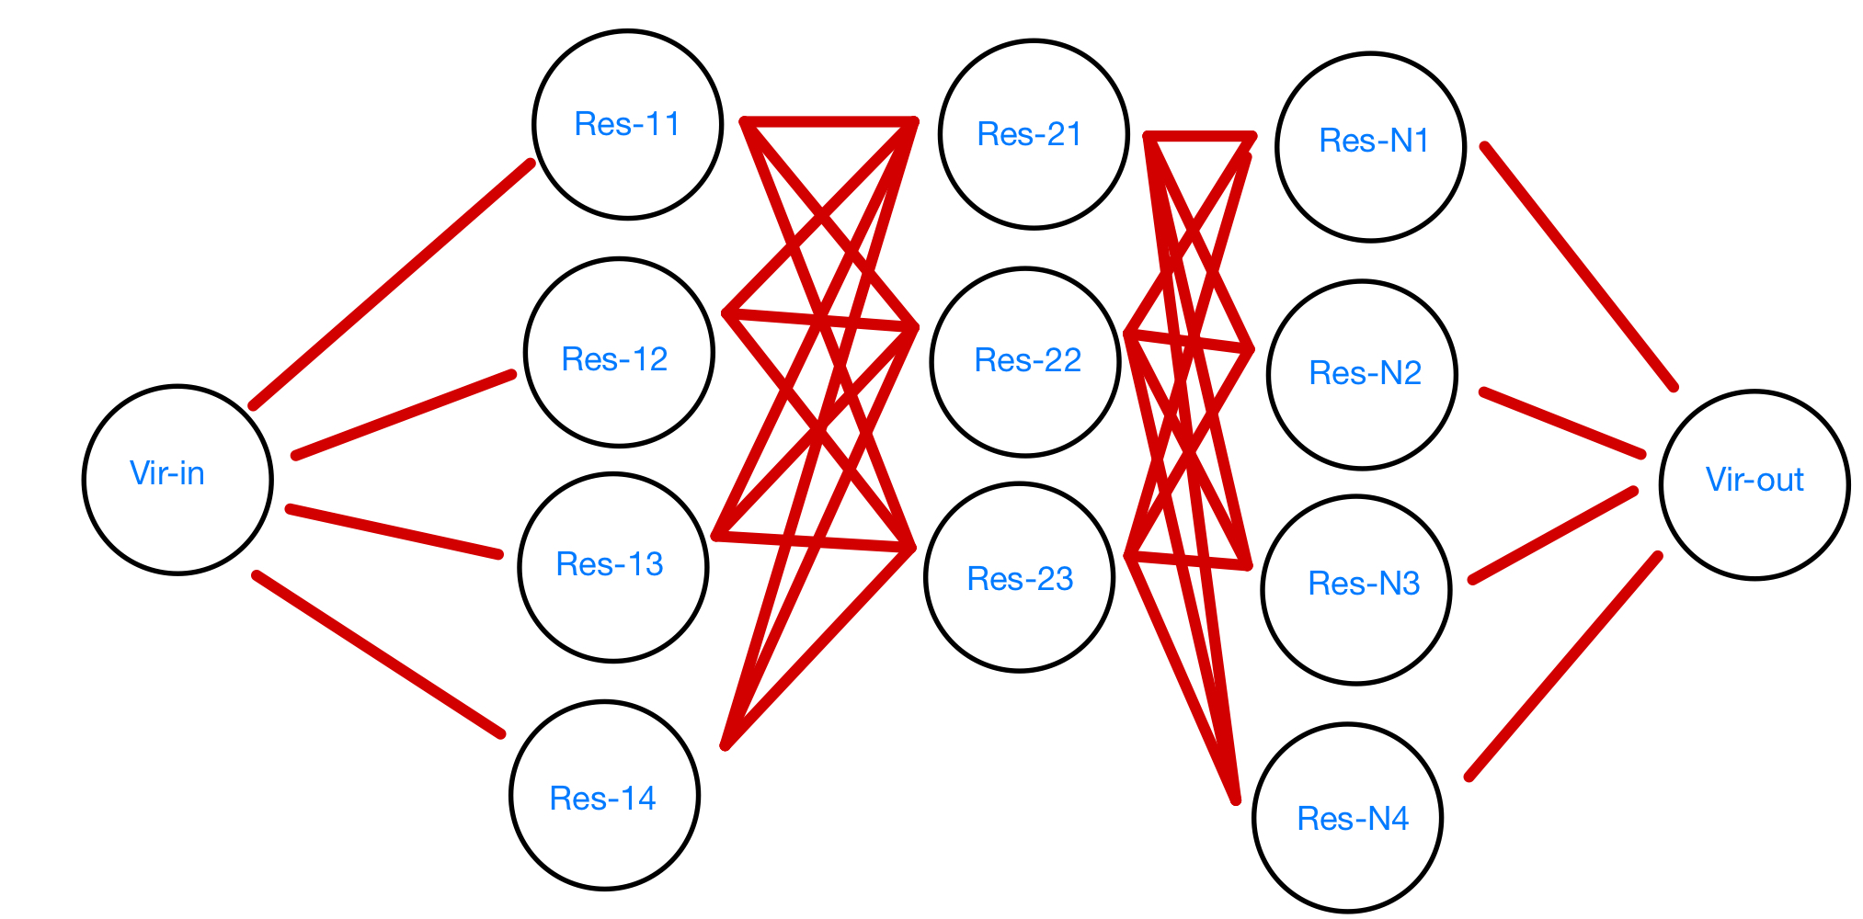
Graph Structure in Model
The graph layout mirrors the structure of the production line, with stages delineated and nodes between adjacent stages fully connected.
Notes:
Each node symbolizes a resource within our environment, illustrating how the production line is represented.
The graph layout mirrors the structure of the production line, with stages delineated and nodes between adjacent stages fully connected.
Dummy nodes are added to the left and right extremes of the graph, linking to the first and last layers of nodes, allowing for bidirectional information flow.
Each node contains a feature vector with all relevant information about the resource and the current order being processed.
This graph-centric perspective emphasizes the relationships between resources, differing from traditional approaches that focus solely on products or operations.

Slide 12
Graph Structure in Model
Each node symbolizes a resource within our environment, illustrating
how the production line is represented.
Dummy nodes are added to the left and right extremes of the
graph, linking to the first and last layers of nodes, allowing for
bidirectional information flow.
Each node contains a feature vector with all relevant information about the resource and the current order being processed.
This graph-centric perspective emphasizes the relationships between resources, differing from traditional approaches that focus solely on products or operations.

Slide 13
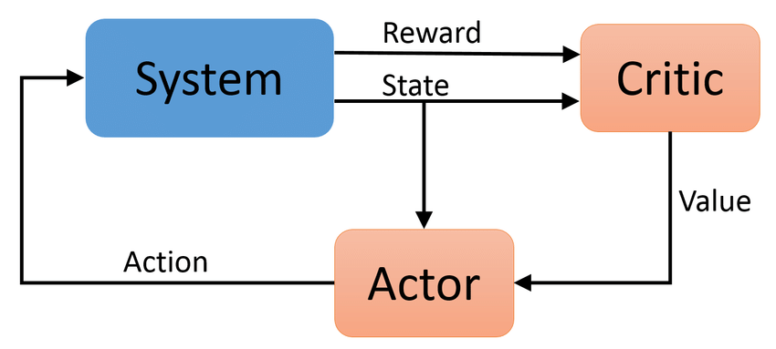
Actor Critic Model
Model Structure
The Actor-Critic model is composed of two separate sub-models, each featuring 3-4 fully connected hidden layers.
The dimensions of these hidden layers and the number of layers themselves are hyperparameters requiring tuning.
Action Mask Application
During each forward step, an action mask is applied to identify valid actions.
This mask is derived from simulations of the environment and plays a vital role in the decision-making process.

Slide 14
Results - Evaluation
To evaluate our model, we devised various setups to assess different aspects of the problem, focusing on two dimensions of complexity: flexibility in resource selection and the incorporation of set-up times.
Flexibility refers to the ability to choose among different resources within a stage for each order, which complicates decision-making by introducing numerous conflicting options.
Set-up times represent the duration required to prepare a resource for processing a different type of product, adding a new dimension to the problem due to their substantial impact on the final outcome.

Slide 15
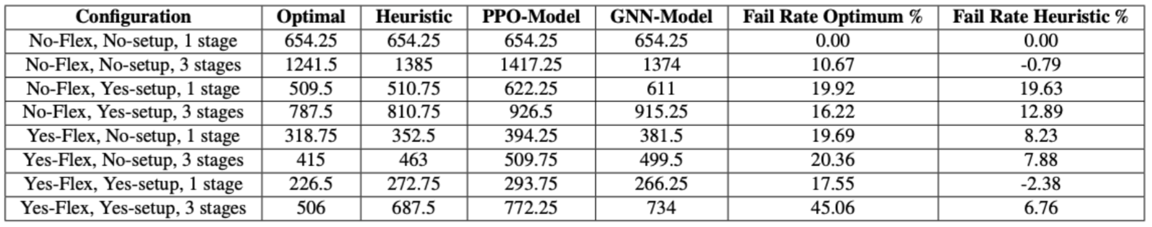
Results - Evaluation
We employed two distinct assessment processes: examining the gaps between the optimal solutions for specific samples and assessing the model's ability to generalize.
For the first assessment, we generated various instances across different configurations, each reflecting the complexities of flexibility and set-up times.
These instances were tested against both the optimal solution and a heuristic benchmark to identify and quantify the gaps between our model’s performance and these reference solutions..

Slide 16
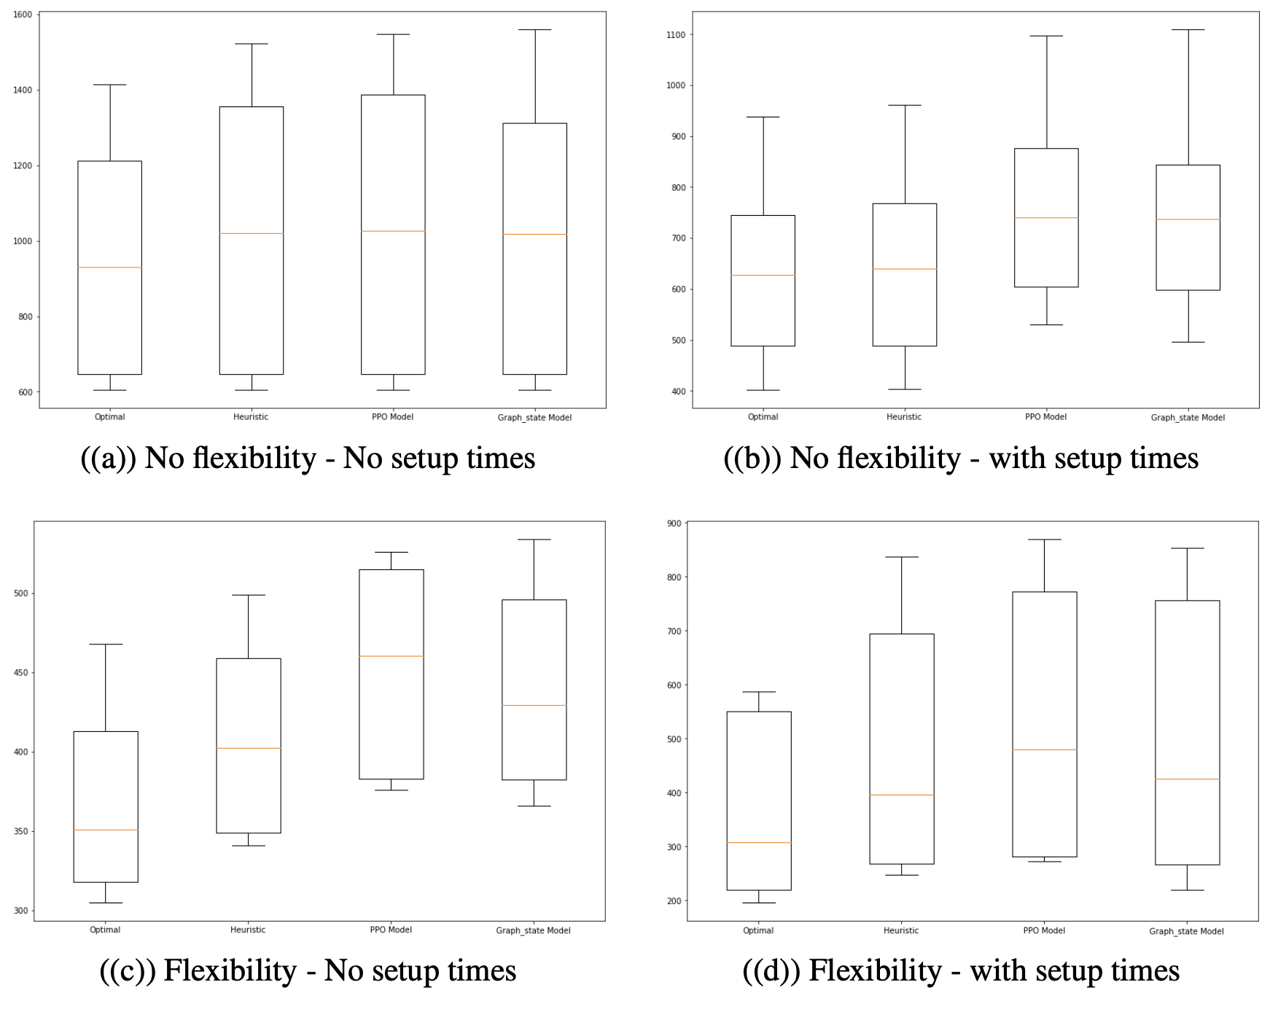
Results
Notes:
Asymptotic Complexity: Landau Symbols

Slide 17
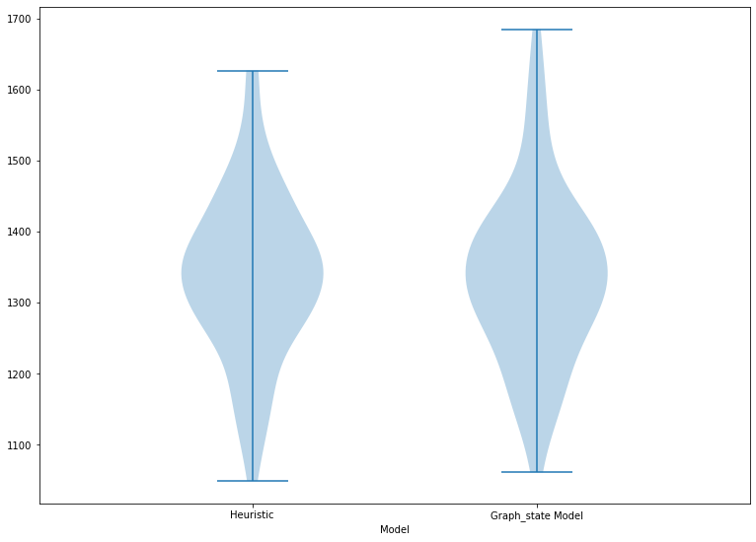
Results - Evaluation
In the second assessment, we focused on a configuration where our model showed promise, generating numerous random instances for training and testing. Given the high computational cost of calculating optimal solutions, we relied solely on heuristic benchmarks for this scenario.
The analysis of the violin plot, supported by additional performance metrics, shows that our model demonstrates commendable generalization abilities, often surpassing the heuristic benchmark.
Notes:
The results, displayed in a violin graph, illustrate the performance distribution and deviations. The heuristic method used in these tests follows a greedy strategy, selecting the action with the shortest operation time at each decision point. While this approach is not optimal, it significantly outperforms random action selection, providing a reasonable benchmark for comparison.

Slide 18
Conclusion - Discussion
In this project, we developed and successfully implemented a simulation environment tailored to address the complexities of the Job Shop Scheduling Problem (JSSP).
Leveraging the capabilities of Deep Reinforcement Learning (DRL), we incorporated the Proximal Policy Optimization (PPO) method to develop a foundational model aimed at optimizing job scheduling.
To enhance the model's representation of dynamic production environments, a Graph Neural Network (GNN) layer was introduced, capturing the state as a graph. This adaptation facilitated greater flexibility in accommodating changes in resource setups, proving the utility of GNNs in representing complex operational relationships.
Notes:
Asymptotic Complexity: Landau Symbols

Slide 19
Conclusion - Discussion
There is substantial scope for refining the system. Further tuning of hyperparameters, experimenting with different network architectures, and integrating more sophisticated learning strategies could potentially enhance performance.
Additionally, incorporating more detailed feedback mechanisms to adjust learning processes in real-time could address some of the shortcomings encountered in this initial implementation.
Continued research and experimentation are essential to unlock the full potential of combining DRL with GNN for complex scheduling tasks, aiming to eventually surpass traditional methods in both efficiency and adaptability.
Notes:
Asymptotic Complexity: Landau Symbols

Slide 20
Thanks for listening!

